Slide 1

6 Components of Optimal Health & Aging©
^{21 May 2013}
Charles B. Christian, Jr. M.D.
Medical Director
Inside Outside
Wellness Center & Medical Spa
San Antonio, Texas
http://www.insideoutsidespa.com

Slide 2

What do We all Want?
Health and Wealth

Slide 3


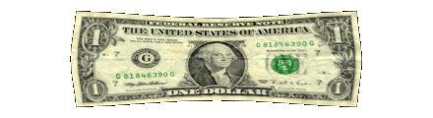
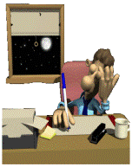
How do you achieve
Health & Wealth?
You Invest
Time
$$$
Energy

Slide 4

4 Questions?
1. Do YOU value your:
Time
$$$
Energy

Slide 5
4 Questions?
2. Do YOU have limited:
Time
$$$
Energy

Slide 6
4 Questions?
3. Do YOU want to use
Time
$$$
Energy
Effectively!

Slide 7
4 Questions?
4. Would YOU like some Suggestions about how You can Invest your
Time
$$$
Energy
More Effectively!

Slide 8


Health = Wealth
“Look to your health and if you have it, value it next to a good conscience…”
Issac Walden

Slide 9
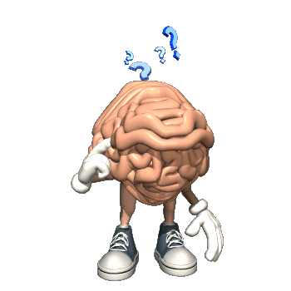
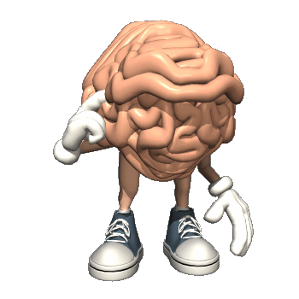
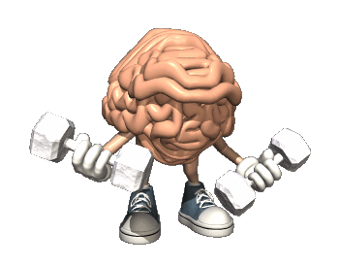
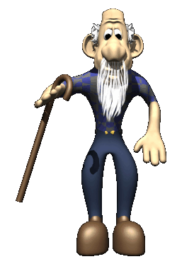
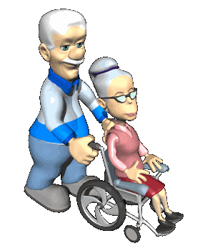
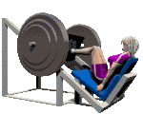
What We Really Fear As We Age
It’s is VERY CLEAR to most
That…
The “Enjoyment” of Life, the Fruits of Your Labors and Especially Leisure Activities depends primarily on your Mental and Physical Health!
Loss of Mental Capacity
Anything you can do to
Maintain your health,
Take it to a new level or
Even Regain Your Health
Is a Wise Investment of Time, $$$ and Energy!
Loss of Functional Capacity

Slide 10

The Doctor as “Teacher”
fDoctor (gen.: doctoris) means teacher in Latin and is an agent noun derived from the verb docere ('teach, guide').
When the Student is Ready, the Teacher will Appear!

Slide 11

The Doctor as “Teacher”
A Doctor’s Primary responsibility is to help people make better decisions and choices about how they Invest their “Time, $$$ and Energy” on Health Related Issues.
To Cure Sometimes
To Relieve Often
To Comfort Always
Hippocrates
Primum Non Nocere
First, Do No Harm

Slide 12

What’s Going to Happen Today
Something Very Fundamental
CHANGE
Change Requires
Useful Information !!
Why!!
How!!
I Need to Overcome
Ignorance
Prejudice
Fear

Slide 13


How Change Happens
Mental Creation
You’re gonna get FLIPPED!!
Physical Creation
Whatever the Mind can Conceive
And Believe
It Can Achieve
N. Hill
Human Beings by changing the inner aspects of their Minds
Can Change the Outer Aspects of Their Lives.
W. James
Analyze
Examine
Understand
WHY
Internalize
Listen
Think
Result
Outcome
Goal
Prize
Aspiration
Aim
End
Purpose
Dream
Objective
Mission
Eat Better
Mind Food
Books
Tapes
Seminars
Facts
Knowledge
Useful
Information
WHYS
Thoughts
Perception
Belief
System
Paradigms
Actions
Behavior
HEAD
HEART

Slide 14

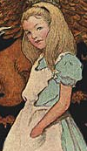
Useful Information
Take advantage of it
You benefit!!
“If you drink much from a bottle labeled ‘poison’, it is almost certain to disagree with you, sooner or later.”
Louis Carrol “Alice in Wonderland”
“Useful Information”
A Bottle Labeled Poison.
Ignore it
You pay a price, sooner or later!!
This is
“Actionable Intelligence”!! 911 Term

Slide 15
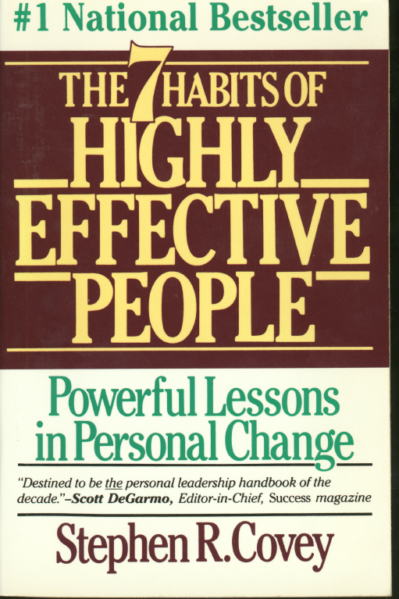

7 Habits of Highly Effective People
Paradigms & Paradigm Shifts
Paradigm: Definition
It is the way we “see” the world.
The way we “think” about things.
Our Belief system is made up of our Paradigms.
Our actions & behavior are based on our Belief System.
My Goal Today
A Paradigm Shift in the way you “see and think” about nutrition and exercise and stress.
After today your behavior toward each of these areas will reflect this shift.
Paradigm Shift : Definition
A change (sometimes sudden) in the way we “see and think” about something or someone.
Our Belief System changes and our actions/behavior change.
“The significant problems we face cannot be solved at the same level of thinking we were at when we created them.”
Albert Einstein

Slide 16
6 Components of an Optimal Health and Aging Program©
Injury Prevention
Routine Checkups, Special Screenings
Nutrition
Exercise
Hormone Optimization
Stress Recognition and Management
“The possession of health makes all things easier, its absence everything more difficult.”
Ben Franklin

Slide 17
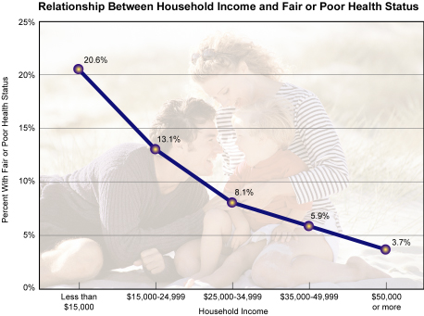
Obstacles to Optimal Health & Aging
Nature has Planned for Reproduction not Longevity
Socioeconomic Class best predictor of Health & Longevity
Social Isolation very bad for Health and Longevity
Lack of Knowledge and Confusion about Information
Lack of Discipline, Inconvenience, Lack of Time
Cost, Insurance pays little for Preventive Measures
Short Term Thinking, Don’t Care Attitude
Environmental Stressors which we can’t control, GRAVITY
Stressful, often Dangerous Lifestyles

Slide 18
6 Components of an Optimal Health and Aging Program©
Injury Prevention

Slide 19

6 Components of an Optimal Health and Aging Program©
Injury Prevention
Rule 1: Don’t flirt with a gangsta’s girlfriend!!
Self Inflicted
Years of Potential Life Lost (YPLL) Reports, 1999 – 2010

Slide 20
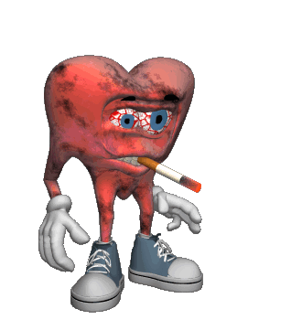
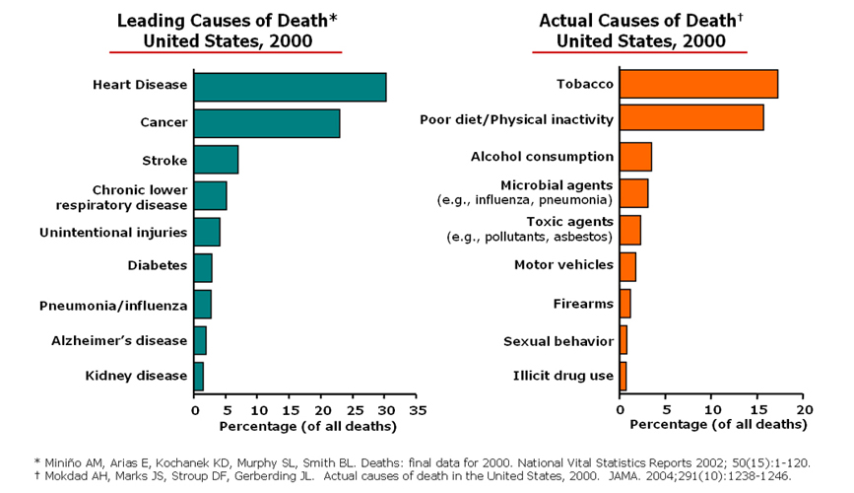
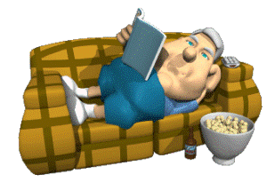


Cause of Death Vs
Actual Cause of Death
“After Tobacco, Poor Nutrition and Lack of Exercise are the main causes of death in this country!”
Everyone must develop effective strategies about
Nutrition and Exercise!!
Rule 1a
Stop Hurting Yourself!!
*Miniño AM, et al Deaths: final data for 2000. National Vital Statistics Reports 2002; 50(15):1–120.
†Mokdad AH, et al Actual causes of death in the United States, 2000. JAMA. 2004;291(10):1238-46.

Slide 21
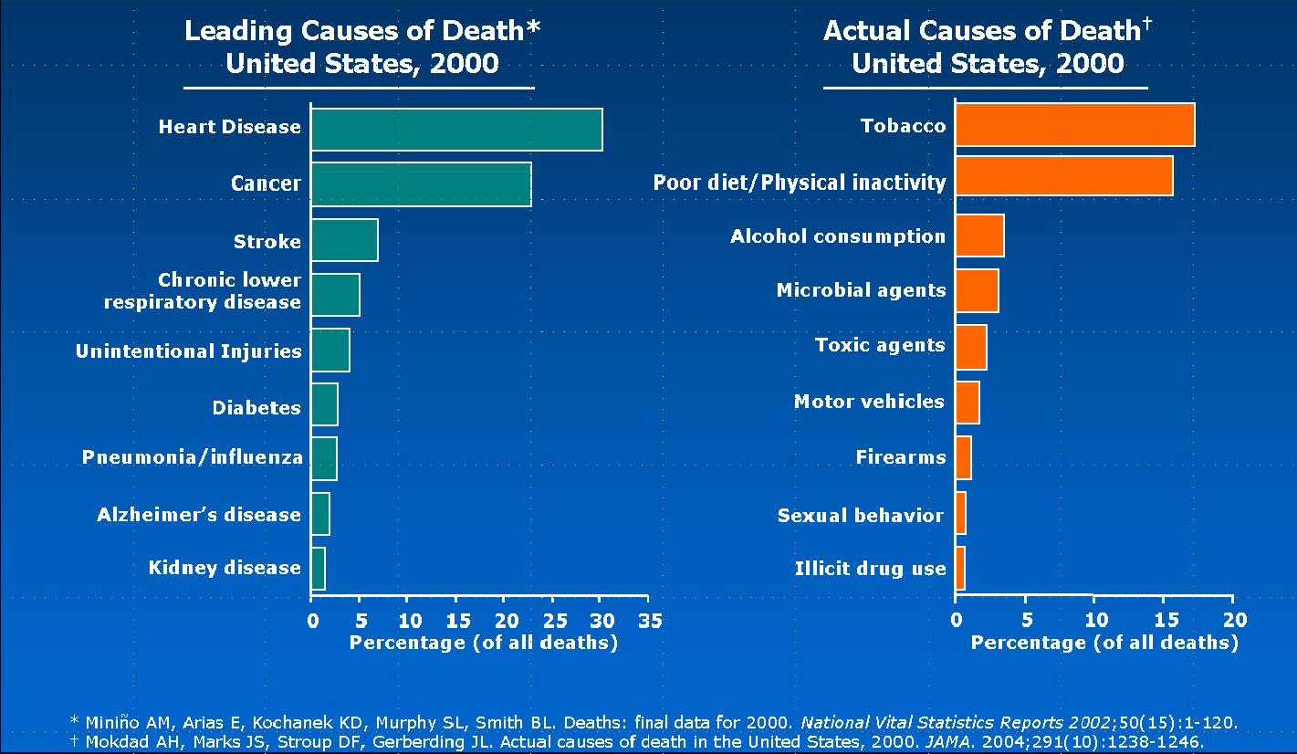

Slide 22
Why we Die Early!
We Live Dangerous Lifestyles!
Dangerous Physical
Wreck our Bodies
“If you drink much from a bottle labeled ‘poison’, it is almost certain to disagree with you, sooner or later.”
Louis Carrol “Alice in Wonderland”
Early Death
Dangerous Metabolic
Wreck our Metabolism

Slide 23
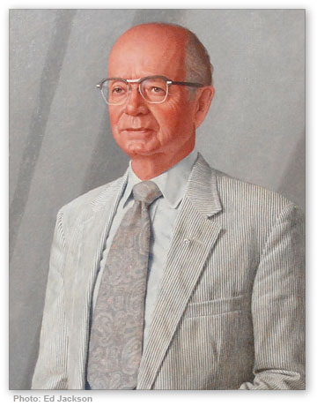

“Governor Maddox, When are we going to have a better prison system in Georgia?”
“We aren’t going to have a better prison system until we have ……
Lester G. Maddox
Georgia Governor
1967-1971
Better Prisoners!!!!!

Slide 24
KEY POINT
There is no system that can compensate for the unwillingness of an individual to take responsibility for his own actions…..

Slide 25



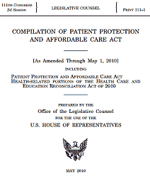
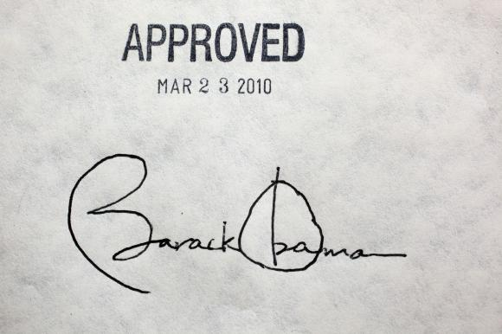
When are we going to have a better health system?
“Better Patients”
We cannot design a health system which can compensate for the unwillingness of an individual to take responsibility for his own actions…..

Slide 26
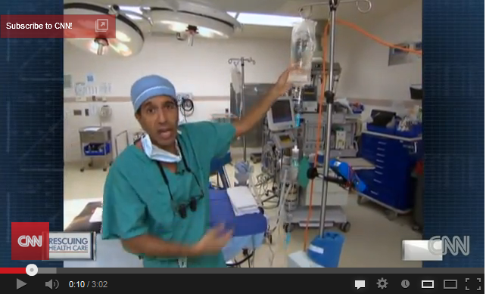
“Escape Fire”
The Fight to rescue American Health Care
http://cnnpressroom.blogs.cnn.com/2013/03/01/cnn-launches-escape-fire-on-cable-television-in-march/

Slide 27
6 Components of an Optimal Health and Aging Program©
Injury Prevention
Routine Checkups & Special Screenings

Slide 28
6 Components of an Optimal Health and Aging Program©
Routine Screening as Per National Medical Societies
Usually uncovers disease at late Stages. “Pathology Present”. Disease has Name.
Functional Screening for Silent Metabolic Disease
Detects abnormal metabolism at cell level prior to Pathology being present.
Genetic Screening for Predisposition for Disease
Not done routinely except for very serious Inherited Genetic disorders. May become more common.

Slide 29

Does our Health Depend More on our Genes or the Environment?
Nature Vs Nurture?
The Genotype - Phenotype Connection
Environment
Genetic Makeup
Genotype
Look at Your DNA
Physical Makeup
Phenotype
Look in the Mirror
Genetics Load the Gun
Environment Pulls the Trigger!

Slide 30
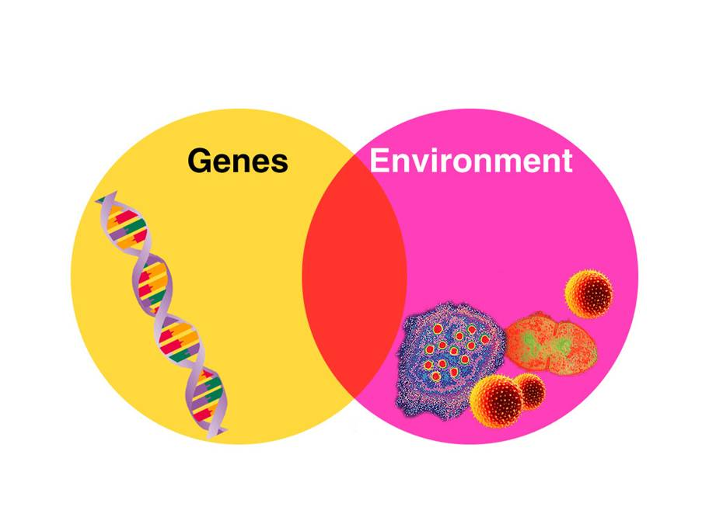
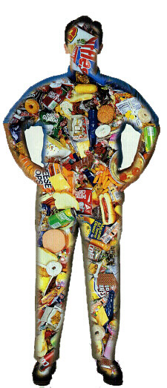
Does our Health Depend More on our Genes or the Environment?
Food We Eat
Rule 2: Get your Checkups!!
Air We Breathe
“You”
What Touches Us
“Bugs”
“Phenotype”

Slide 31
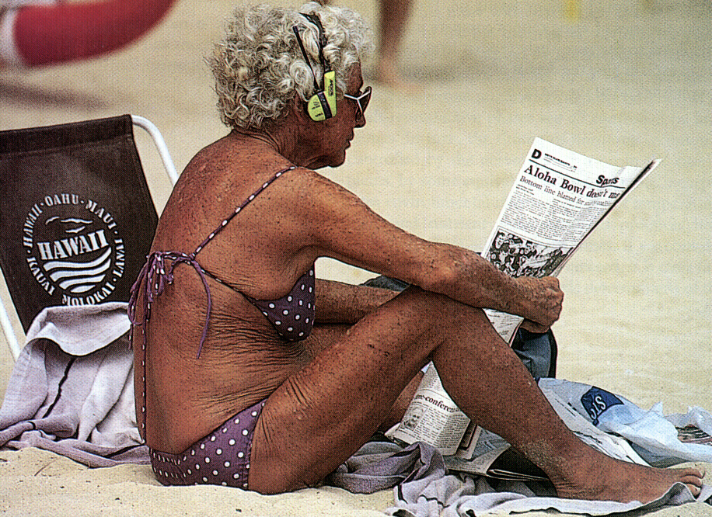



Deck Example
New
Protected
Weathered

Slide 32
6 Components of an Optimal Health and Aging Program©
Injury Prevention.
Checkups.
Nutrition
Exercise

Slide 33

The Optimal
“Health Prescription” for America’s Health & Fitness Crisis
+
Nutrition
Exercise
The Problem
How to help define these two strategies for people
“Frustration”

Slide 34

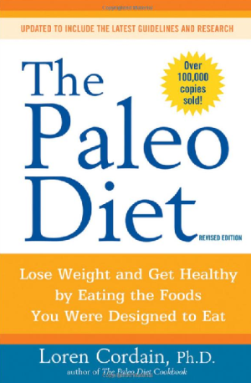
The Optimal
“Health Prescription” for America’s Health & Fitness Crisis
Hi-Lo Strength Training
+
RESULTS

Slide 35
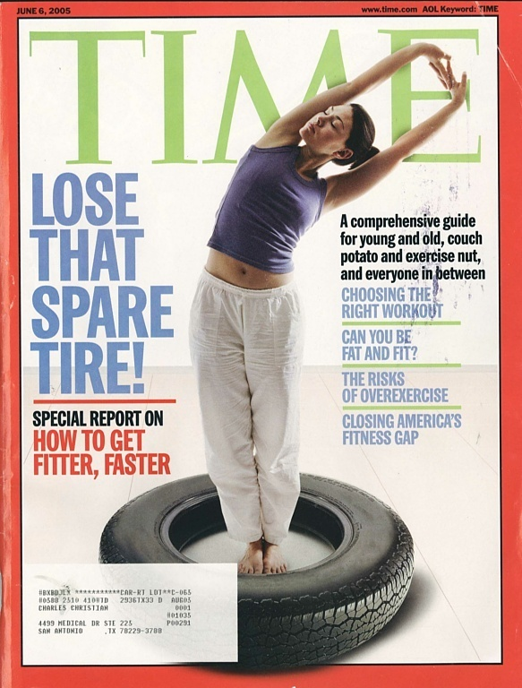
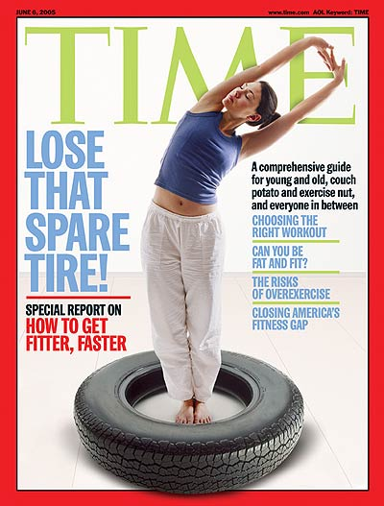
What to do?
Time
June 6, 2005
Does Exercise really help with Weight Loss?
http://www.time.com/time/magazine/0,9263,7601050606,00.html

Slide 36
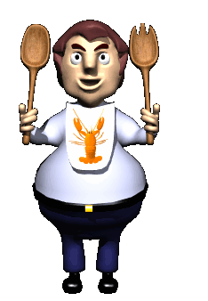
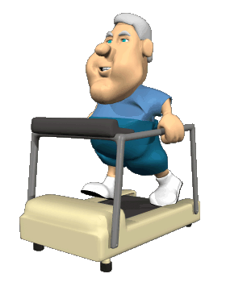
“You can eat 24 hours a day and maybe exercise 1 hour a day!!”
Dr. Sears
“It is easier to push away from 100 Calories than to figure out a way to burn 100 Calories”
“There is no way that activity can compete with the mouth…”
It is Important to Rely Primarily on a Reduced Calorie Diet to Lose Fat, Not Exercise!!

Slide 37
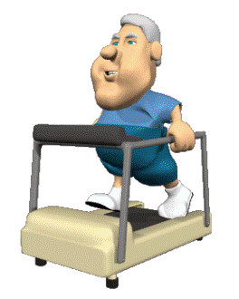
Common Strategies
To Lose Weight
Cut Back on Calories
Problem: Lose 70% Fat and 30% Muscle
2.Cut Back on Calories + Aerobics
Problem: Lose Fat and Actually More Muscle
3.Cut Back on Calories + Strength Training
Solution: Lose Fat and Maintain or Muscle
Adequate Protein
+
Adequate Stimulation
+
Adequate Time to Recover & Grow

Slide 38
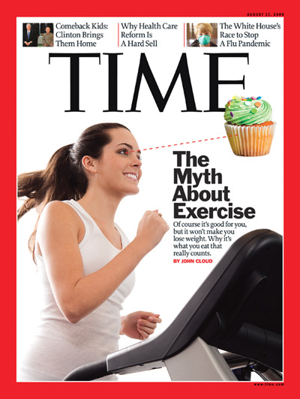
Time
Aug 27, 2009
Finally they get it Right!!
Exercise Makes You Hungry!
http://www.time.com/time/magazine/article/0,9171,1914974,00.html

Slide 39
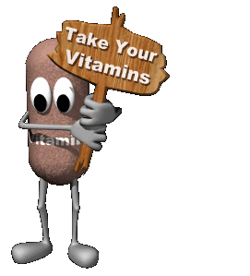
Nutrition 101
“Diet” or“Approach to Food”
“Supplement Program”
Macronutrition gm/day Micronutrition mg/day
Carbohydrates CBO
Fat FAT
Protein PRO
Fiber
Water
Minerals 60 have physiologic value
Vitamins 13
Essential Amino Acid 11
Essential Fatty Acids (Fish Oil) 2
Probiotics
Digestive Enzymes
“Nutrition”
“Calories”
Rule 3: Learn How to Eat!!
Vitamin C
6omg
500mg-2gm
100gm
1. Prevent Deficiency Dx: Beriberi,
Scurvy, Rickets
2. Prevent Chronic Diseases
Slow the Aging Process
Improve Athletic Performance
3. Reverse Chronic or Acute Diseases

Slide 40
Proper Nutrition
Confusing Messages!
Let’s Write a
“Nutrition Prescription”
Zone/Paleo Answers all these questions very well!!
What Ratio?
Carbohydrates
Fat
Protein
How Much?
What Kind?
How Often?

Slide 41
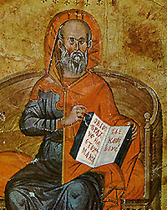
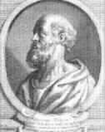
Hippocrates 470 –360BC
  “Let food be your medicine and let medicine be your food.”
  Hippocrates

Slide 42
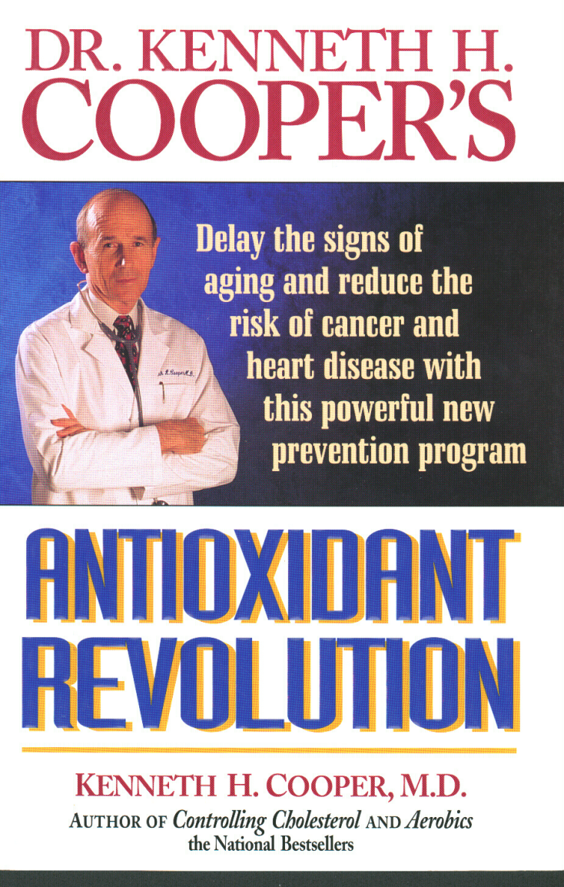
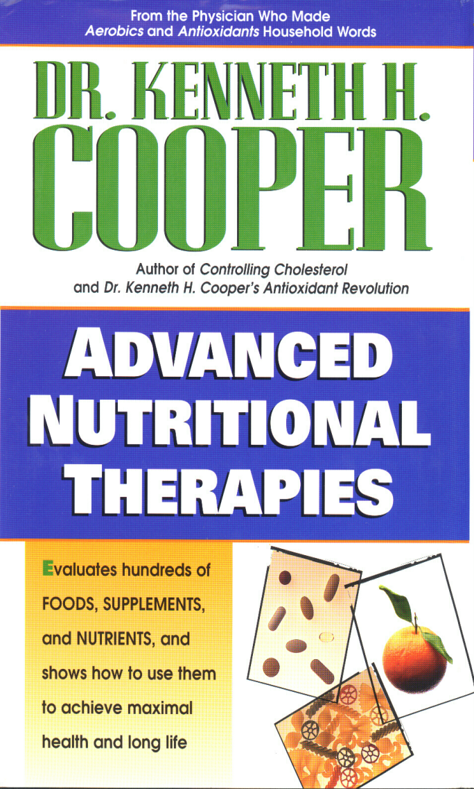
Ken Cooper M.D. on Nutrition
“As a result of my growing belief in the power of nutrition, I am acutely aware of the importance of every mouthful of food I take.”
Kenneth Cooper M.D.

Slide 43
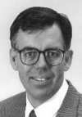
Food, A Powerful Medicine
“Food is the most powerful drug that you will ever encounter. Learning how to control hormonal responses to food is your passport to entering and staying in the Zone."
Dr. Barry Sears

Slide 44
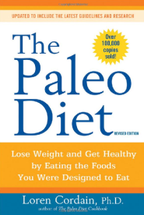
Food and food types found in Western diets generally unavailable to preagricultural hominins..
Origins and evolution of the Western diet: Health Implications for the 21st century
Loren Cordain, S Boyd Eaton
Dairy products % of energy
Whole milk 1.6
Low-fat milk 2.1
Cheese 3.2
Butter 1.1
Other 2.6
Total 10.6
Cereal grains
Whole grains 3.5
Refined grains 20.4
Total 23.9
Refined sugars
Sucrose 8.0
High-fructose corn syrup 7.8
Glucose 2.6
Syrups 0.1
Other 0.1
Total 18.6
Refined vegetable oils
Salad, cooking oils 8.8
Shortening 6.6
Margarine 2.2
Total 17.6
Alcohol 1.4
Total energy 72.1%
Added salt, as sodium chloride 9.63gm
“…. the ultimate factor underlying diseases of civilization is the collision of our ancient genome with the new conditions of life in affluent nations, including the nutritional qualities of recently introduced foods.”
L. Cordain et al
We are not Genetically designed for 72% of Calories generally available to us!!
Cordain L et al Am J Clin Nutr 2005;81:341–54.

Slide 45


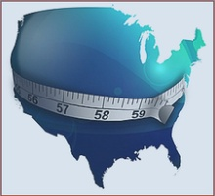

Obesity Trends* Among U.S. Adults
BRFSS, 1990, 2000, 2010
(*BMI ≥30, or about 30 lbs. overweight for 5’4” person)
1990
2000
Based on these trends 50% of all adults are predicted to be in the Obese Category BMI>30 by 2030.
Obesity, Jul 2008
2010
1.Miss 34%
2.WVa 32.5%
3.Ala 32.2%
4.SCa 31.5%
5.Ken 31.3%
6.TX 31%
6.Lou 31%
Black 49.5%
Hispanic 39.1%
Whites 34.3%
No Data <10% 10%–14% 15%–19% 20%–24% 25%–29% ≥30%
http://www.cdc.gov/obesity/data/adult.html

Slide 46


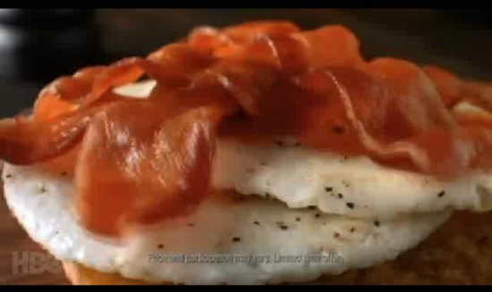
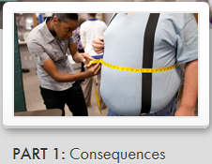

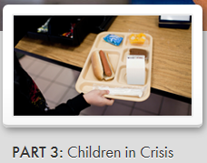
“The Weight of the Nation” HBO 4 Part Special 2012
Trailer
http://theweightofthenation.hbo.com/

Slide 47

What’s Left to Eat??
Hint: It’s what your Grandmother said!
Charlie!
Eat that Meat!
Charlie!
Eat those Vegetables
Charlie!
Gag down this Cod Liver Oil!
You are one Puny Kid!!

Slide 48
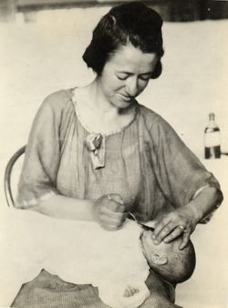
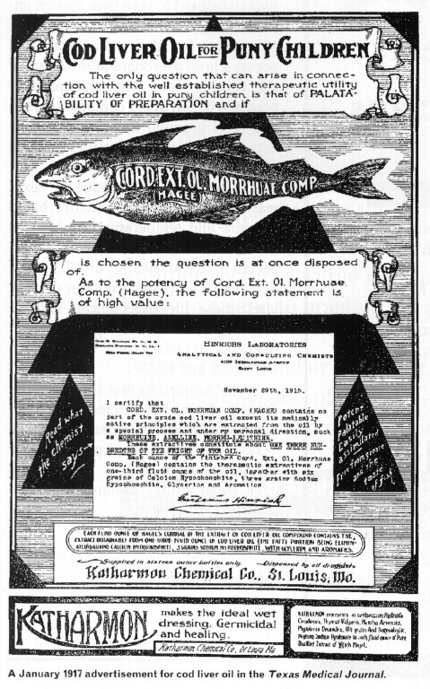

1917 Texas Medical Journal
Did your GrandMother ever give you Cod Liver Oil?
“The biggest mistake we have made in the last 30 years is that we stopped giving our kids a tablespoon of Cod Liver Oil each day!!”
Barry Sears Phd
Cod Liver Oil Contains the very Healthy Omega 3 Fat found in Fish!!
“If you have only 15 seconds in a day to take care of yourself, in those 15 seconds, gag down as much fish oil as you can!”
Barry Sears Phd
“When babies don’t swallow their daily dose of cod liver oil, their mothers are usually to blame …”

Slide 49
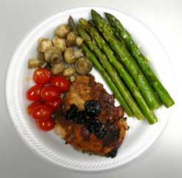
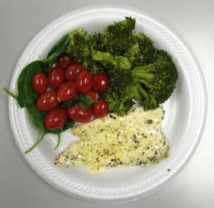
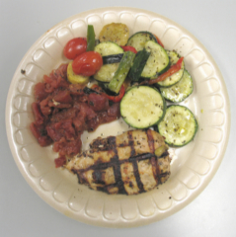
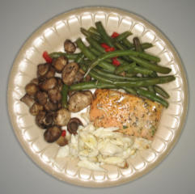
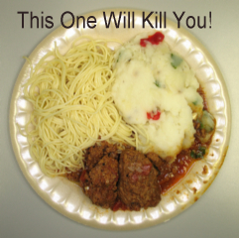
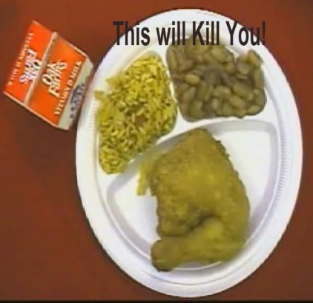
300-400 Calorie Meals
Bottom Line
Any 2 vegetables/fruit +
Any 3-4 Oz Meat will be only
300-400 Calories!!
Any Dessert might add 200 cal
Beer/Glass of Wine add 150cal
Now you are at
650- 750 Calories!!!
More 300-400 Cal Meals

Slide 50

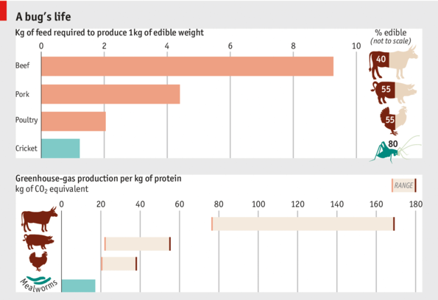
Let’s Eat Insects!!
"entomophagy," a fancy term for the eating of insects
WHO by 2050
We will be
Eating Insects!
New source of fuel for humans!! Could this be NuStar’s Next Adventure?
http://www.economist.com/blogs/graphicdetail/2013/05/daily-chart-11

Slide 51
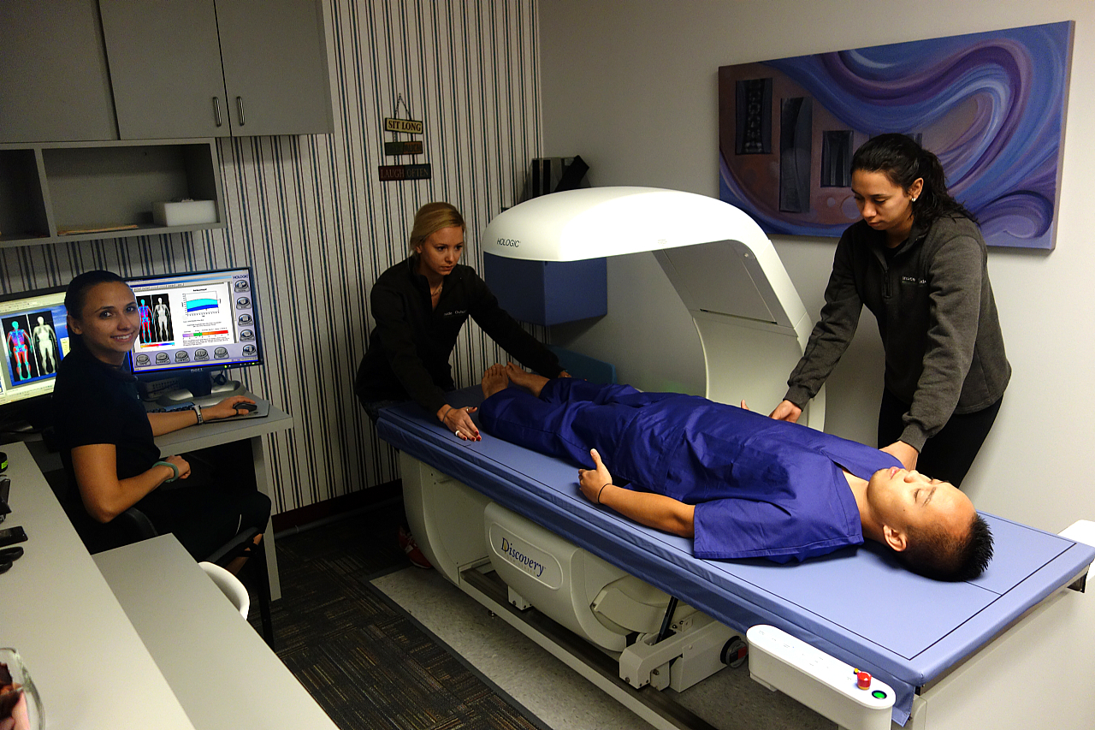



DXA Body Composition Testing!!
It is good to set goals and have some way to measure your progress.

Slide 52

Setting Your Goals!
Your Modified Zone/Paleo Prescription
Based On
DXA Body
Composition Scan

Slide 53
6 Components of an Optimal Health and Aging Program©
Injury Prevention
Checkups
Nutrition
Exercise
Strength Training (Maintain Muscle Mass)
Aerobic Training
Flexibility Training

Slide 54

IF You Were To Exercise? Confusing Messages!!
Let’s Write a
“Exercise Prescription”
Where?
By Whom?
What Kind?
How Much?
How Intense?
How Often?
How To Measure Progress?
How to Progress?

Slide 55










Confusing Messages!!
What Kind, How Much/Often/Intense
Tony Robbins

Slide 56

Physical activity and public health: updated recommendation for adults from the American College of Sports Medicine & the American Heart Association, 2007.
Haskell WL et al American College of Sports Medicine; American Heart Association. Stanford University, USA
Circulation, 2007 Aug 28; 169: 1081-1093
Recommendations Age 18-65
Moderate Intensity Aerobic 30min “Brisk Walk for 1.5mi” for 5 Days
Note: 10min x 3 as good as 30min
Or
Vigorous Intensity Aerobic 20min “Jog for 1.6miles” 3 Days
Or
Combination Walk 2 days, Jog 2 Days
Plus
Strength Training Twice a Week
Note: Running or Walking 5 Miles = Same Calories Burned
http://circ.ahajournals.org/content/116/9/1081.long

Slide 57
Walking versus running for hypertension, cholesterol, and diabetes mellitus risk reduction.
Williams PT, Thompson PD.
Life Sciences Division, Lawrence Berkeley National Lab, Berkely CA.
Arterioscler Thromb Vasc Biol. 2013 May;33(5):1085-91
National Runners’ (n=33,060) Study
Walkers’ (n=15,945) Health Study
Running Vs Walking over 6.2 years
New Onset
Hypertension, Cholesterol, Diabetes
Caveat: Self Reported Study
CONCLUSIONS: Equivalent energy expenditures by moderate (walking) and vigorous (running) exercise produced similar risk reductions for hypertension, hypercholesterolemia, diabetes mellitus, and possibly CHD.
http://www.ncbi.nlm.nih.gov/pubmed/23559628?dopt=Abstract

Slide 58

CBC Walking
This Amount of Walking is about 3 Times more than the AHA Recommendations.

Slide 59























IF You Were To Exercise? Confusing Messages!!
Why am I doing this?

Slide 60
What We Fear As We Age
Loss of Mental Capacity
“You can never go back and have a new beginning,
but.. you can start NOW and have a new ending.”
Carl Bard
Loss of Functional Capacity

Slide 61

Loss of Strength and Muscle Mass as We Age
Young
Older
Muscle = Functional Ability
Sarcopenia = Less Muscle
Uniform Characteristic of Aging
Evans, W. et al. “Biomarkers, The 10 Keys to Prolonging Vitality” 1992.

Slide 62

Muscle Loss = Functional Disability
Lose Muscle and Lose Activities of Daily Living (ADL)!
Zuliani G et al Nutritional Parameters, Body Composition, and Progression of Disability in Older Disabled Residents Living in Nursing Homes. The Journals of Gerontology Series A: Biological Sciences and Medical Sciences 56:M212-M216 (2001)
Notes:
Figure 1. Two-year body cell mass (BCM) modification ( BCM: 2-y value - baseline value). Subjects were divided into six groups based on the number of additional activities of daily living (ADLs) lost at follow-up (0–5 ADLs lost). Test for linear trend was ascertained from the linear regression model with the number of ADLs lost entered as an ordinal variable.

Slide 63

Biomarkers of Aging
Biomarkers of Vitality That You Can Change
Muscle Mass
Strength
Basal Metabolic Rate
Body Fat Percentage
Aerobic Capacity (Muscle Oxidative)
Blood Sugar Tolerance
Cholesterol/HDL Ratio
Blood Pressure
Bone Density
Internal Temperature Regulation
Evans and Rosenberg “Biomarkers, The 10 Keys to Prolonging Vitality” 1992

Slide 64

Strength Training
Evans and Rosenberg “Biomarkers, The 10 Keys to Prolonging Vitality” 1992

Slide 65


Strength Training Aerobic Capacity
Evans and Rosenberg “Biomarkers, The 10 Keys to Prolonging Vitality” 1992

Slide 66
  Sarcopenia and Aging
  Kamel HK Nutr Rev. 2003 May;61(5 Pt 1):157-67
  “Sarcopenia, or age-related decline in muscle mass and function, is a recently recognized epidemic that constitutes a great threat to the functional independence and quality of life of older adults.
  “At present, progressive resistance training is the best intervention shown to slow down or reverse this condition.”
http://www.ncbi.nlm.nih.gov/entrez/query.fcgi?cmd=Retrieve&db=PubMed&list_uids=12822704&dopt=Abstract

Slide 67
Exercise Comes of Age
Rationale and Recommendations for a Geriatric Exercise Prescription
“However, unlike many other changes that impact on exercise capacity, muscle mass cannot usually be maintained into old age even with regular aerobic activities in either general populations or master athletes.
Only overloading of muscle with resistance training has been shown to largely avert losses of muscle mass and strength in older individuals.
These researchers found that elderly men who swam or ran had similar measures of muscle size and strength as their sedentary peers, whereas the muscle of older men who had been weight lifting for 12–17 years was almost indistinguishable, and even superior in some aspects, to healthy men 40 to 50 years younger than them. “
Singh M Exercise Comes of Age . Rationale and Recommendations for a Geriatric Exercise Prescription The Journals of Gerontology Series A: Biological Sciences and Medical Sciences 57:M262-M282 (2002

Slide 68





https://www.healthstudies.umn.edu/nunstudy/

Slide 69


See what happens when
you have no muscles!
Yuk

Slide 70
The “Silent” Epidemic
Loss of Muscle Mass as we Age
"Sarcopenia"
“The Cure”
High Intensity
Low Velocity
Hi-Lo Strength Training®
Inside Outside’s Version of High Intensity Training (HIT)

Slide 71

?? Why Hi-Lo ??
The Goal of Strength Training
Increase Strength & Muscle Postpone Entry Into the Disability Zone!!
Raise Your Metabolism to slow fat accumulation

Slide 72


?? Why Hi-Lo ??
It Combats “Sarcopenia”
“Sarcopenia” is the loss of muscle & strength which as we age.
Get Weak!
I don’t want to end up in a wheelchair!
Loss of Muscle and Strength lead to many forms of disability as we age.
Get Fat!
Lose muscle Metabolic Rate
If you don’t calories you get fat.
Yuk, Weak & Fat…..

Slide 73

?? Why Hi-Lo ??
It is Safe
No More trauma from Aerobics!
Exercise should be safe.
Exercise should build strength!
Because it is Slow, it is safe.
f=ma
Force = Mass X Acceleration

Slide 74



Simply Put
The Benefits of Aerobic or Steady State Activity are
probably overrated especially as a long term strategy for exercise.
These activities serve as a good source of recreation, social interaction and do relieve stress, but they do not satisfy a definition of exercise.
Bush gets “Boomeritis”

Slide 75
?? Why Hi-Lo ??
It is Effective
I won’t do anything for very long if I don’t see RESULTS!!
Hi-Lo is a SAFE form of High Intensity Strength Training.
The High Intensity insures that the muscles get the stimulation they need to get stronger, more resistant to injury and bigger.
Muscles only respond to Intensity!

Slide 76

?? Why Hi-Lo ??
It is Effective Because it is Intense
Short Movie Clip Showing High Intensity during a 6 Machine 16 Minute whole body circuit workout!
These are the last 2 repetitions of a 1Minute 42 sec Set!

Slide 77

?? Why Hi-Lo ??
It is Timewise
We always Look for the least amount of exercise that produces the desired results!
Now I can have a Life and be fit too!!!
Treat Exercise Like a Drug
Not too much..
Not too Little..
Doing more
Wastes time and risks Injury.
By definition, anything intense cannot be done for a long time.
The workouts are done twice a week.
They last barely 20 minutes
Oops, I don’t have a time excuse anymore!!!
Exercise Not Same As your Recreation!
Strength Training makes your Recreation
Safer and More Enjoyable!!

Slide 78



?? Why Hi-Lo ??
It Stresses the Heart and Lungs
I won’t have to do Aerobics!!!!!
And I Won’t Sweat!!!
It Creates Fat Burning Muscle
This is a nice Benefit, a Higher Metabolic Rate all 24hrs.

Slide 79

?? Why Hi-Lo ??
It improves Flexibility
It improves Balance
I will be able to bend over and pick things up without falling!!

Slide 80
Hi-Lo Basic Concepts
Work out The Entire Body – 5 - 6 Machine Circuit
1 Set Only, 6-8 Reps
8-10sec Positive, 8-10sec Negative, Don’t Rest
Work to Momentary Failure or Near Failure
Minimal or No Rest Between Machines
Adequate time for Recovery
Adequate time for Growth
Precise Progression of Intensity as you get stronger
First 4 Months Twice a Week, then Weekly

Slide 81





Typical 5 Machine Whole Body Hi-Lo Circuit Workout
4 Upper Body: 2 Pulling, 2 Pushing
1 Lower (Legs, Buttocks) Body: 1 Pushing, 1 Pulling
Pulldown
Overhead Press
Leg Press
Chest Press
Row

Slide 82


The Repetition Cycle
Negative
10 Seconds
Weights go Down
This form of exercise fatigues the targeted muscles rapidly and safely.
We will usually only do 6-8 repetitions.
Creates a Powerful Stimulus for
Reps 1,2,3 Hard Reps 4,5,6 Very Hard Reps 7 or 8 Fail
Positive
10 Seconds
Weights go Up
Metabolic, Structural and
Whole Body Physiologic Changes
Bottom Out
Rules of the Bottom Out
The set should be over in about 2 – 2 1/2 minutes, Then Go to next machine
Start
Always Bottom Out
Don’t Unload or Rest
Don’t Fire Out

Slide 83

If there is a single “Anti-Aging Strategy” it has to be High Intensity Strength Training!
We’re gonna “Youthanize” not “Euthanize” You!
Rule 4: Get your Vitamin “X”!!
Think Strength Training!!
“596 Genes returned back to youthful levels in Skeletal Muscle after 6 Months of Resistance Training. Many of these were related to Mitochondrial Function which controls energy production in the muscles!”

Slide 84

Physiologic Monitoring 6 Min CBC Workout
Not the typical Whole Body Workout Most Clients Do.
http://www.youtube.com/watch?v=FFLvtTpZpWc

Slide 85

Physiologic Monitoring 6 Min CBC Workout
Not the typical Whole Body Workout Most Clients Do.
http://www.youtube.com/watch?v=FFLvtTpZpWc

Slide 86



HIT or HIIT
HIT - High Intensity (strength) Training
HIIT - High Intensity Interval (aerobic) Training
HIT HIIT
Anaerobic + Aerobic Aerobic Primarily
Circuit with Machines Cycle, Running, Swimming
Slow Steady Intensity Fast 20-30 sec burst, then slow
Safer May cause injury f=ma
Timewise Timewise
Lifelong Strategy Poor Lifelong Strategy

Slide 87


Gretchen Reynolds
9 May 13
30 Seconds
10 Second Rest
Repeat Circuit x 3
Probably OK for
Younger
Would be difficult to do this as you age. Certainly risk of Injury is High.
http://well.blogs.nytimes.com/2013/05/09/the-scientific-7-minute-workout/

Slide 88




Gretchen Reynolds
3 Apr 13
16 Nov 11
Static Stretching does not appear to
Reduce or Prevent Soreness
Prevent Injuries
And May Worsen Performance
Dynamic Stretching or Warm Up Activities
are probably helpful.
http://well.blogs.nytimes.com/2011/11/16/the-right-reasons-to-stretch-before-exercise/
http://well.blogs.nytimes.com/2013/04/03/reasons-not-to-stretch/

Slide 89

Gretchen Reynolds
Do We Have to Cool Down After Exercise?
13 Apr 13
“Do you often, if guiltily, skip cooling down after exercise? A small but soothing body of new research suggests that you aren’t missing out on much. .”
http://well.blogs.nytimes.com/2013/04/24/do-we-have-to-cool-down-after-exercise//

Slide 90

The Confluence of 5 Epidemics
"Sarcopenic Obesity"
Diabetes, Osteoporosis & Boomeritis"
"The Cures"
Hi-Lo Strength Training
+

Slide 91
There are No Epidemics of
Lack of
“Cardiovascular Fitness”
Or
"Lack of Flexibility"

Slide 92
6 Components of an Optimal Health and Aging Program©
Injury Prevention
Checkups
Nutrition
Exercise – Vitamin X
Hormone Optimization
Estrogen
Progesterone
Testosterone
Growth Hormone
DHEA
Melatonin
Thyroid
Good Eicosanoids
Insulin
Cortisol
Bad Eicosanoids
As we age

Slide 93





Hormones and Aging
Rule 5: Optimize your Hemomes and Hermones
Lamberts, WJ et al The Endocrinology of Aging, Science Vol. 278, 17 Oct 97.

Slide 94

6 Components of an Optimal Health and Aging Program©
Injury Prevention.
Checkups
Nutrition
Exercise – Vitamin X
Hormone Optimization.
Stress Recognition and Management.

Slide 95
Stress Response
Long Term Effects
Fatigue, Weakness due to Myopathy
Hypertension and risk of Atherosclerosis
Supression of:
Digestion: Ulcers, Irritable Bowel, Colitis
Reproduction: Impotency and Amenorrhea
Growth: Osteoporosis and poor repair
Neurological: Memory loss
Immune Function: Susceptible to Infections

Slide 96





Understand Effects of Stress
Robert Sapolsky PhD. Stanford University Stress Researcher
http://www.youtube.com/watch?v=eYG0ZuTv5rs

Slide 97


Depletion or Renewal
Sympathetic
Parasympathetic

Slide 98


Decrease Effects of Stress
iPhone, iPad, Computer based program to Lower Sympathetic tone and improve Heart Rate Variability
http://www.heartmath.com/

Slide 99

Worst Kind of Stress!!
Rule 6: Learn why zebras don’t get ulcers!!
The Hostile Personality, We take everything Personal!!

Slide 100


The Health Triad
Diet-Exercise-Sleep
"Sleep, that knits up the ravell'd sleave of care.
The death of each day's life,
sore labour's bath, balm of hurt minds, great nature's second course,
chief nourisher in life's feast."
Shakespeare, MacBeth, Act II.
If you want to feel better and think better, get a week of 8 hour nights of sleep!!
http://www.sleepfoundation.org/article/sleep-topics/diet-exercise-and-sleep/

Slide 101
Associations of job strain and lifestyle risk factors with risk of coronary artery disease: a meta-analysis of individual participant data. 7.3 Year Followup
Kivimaki M. et al Canadian Med Jour 2013 May 13 (Epub ahead of Print)
Job Strain (Psychosocial Work Stress) +Risk Factors + Healthy Lifestyle
Reduces Risk of Heart Disease by 50%!
Defined Risk Factors
No Smoking (yes or no)
Physical Inactivity (yes or no)
Heavy Drinking >28 Drinks/Week
Obesity BMI >30
Job Demand Control Scale Questionnaires
http://www.cmaj.ca/content/early/2013/05/13/cmaj.121735.full.pdf

Slide 102

Associations of job strain and lifestyle risk factors with risk of coronary artery disease: a meta-analysis of individual participant data. 7.3 Year Followup
Kivimaki M. et al Canadian Med Jour 2013 May 13 (Epub ahead of Print)
Job Strain (Psychosocial Work Stress) +Risk Factors +Healthy Lifestyle
Reduces Risk of Heart Disease by 50%!
Defined Risk Factors
No Smoking (yes or no)
Physical Inactivity (yes or no)
Heavy Drinking >28 Drinks/Week
Obesity BMI >30
Job Demand Control Scale Questionnaires
http://www.cmaj.ca/content/early/2013/05/13/cmaj.121735.full.pdf

Slide 103


Associations of job strain and lifestyle risk factors with risk of coronary artery disease: a meta-analysis of individual participant data. 7.3 Year Followup MetaAnalysis
Kivimaki M. et al Canadian Med Jour 2013 May 13 (Epub ahead of Print)
Healthy Lifestyle = No Risk Factors
Moderately Unhealthy Lifestyle = 1 Risk Factors
Unhealthy Lifestyle = 2-4 Risk Factors
Almost 3x Risk!
http://www.cmaj.ca/content/early/2013/05/13/cmaj.121735.full.pdf

Slide 104

Reduction in the risks for hypertension, hypercholesterolemia, and diabetes mellitus vs baseline metabolic equivalant hours per day (METh/d) energy expended by walking or running.
The risk reductions were not significantly different for running than walking for diabetes mellitus (P=0.94), hypertension (P=0.06), or CHD (P=0.26), and only marginally greater for walking than running for hypercholesterolemia (P=0.04).
CONCLUSIONS: Equivalent energy expenditures by moderate (walking) and vigorous (running) exercise produced similar risk reductions for hypertension, hypercholesterolemia, diabetes mellitus, and possibly CHD.
Williams P T , and Thompson P D Arterioscler Thromb Vasc Biol 2013;33:1085-1091
Copyright © American Heart Association
Notes:
Reduction in the risks for hypertension, hypercholesterolemia, and diabetes mellitus vs baseline metabolic equivant hours per day (METh/d) energy expended by walking or running. Energy expenditure (x axis) is categorized in terms of the upper limit of the minimum recommended physical activity levels (750 METmin/wk=1.8 METh/d),² for example, 1- to 2-fold higher activity covers from 1.8 to 3.6 METh/d, etc. The average energy expended by runners and walkers within each interval were 314 and 371 METmin/wk for <1-fold of the recommended levels (<1.8 METh/d), respectively; 1208 and 1108 METmin/wk for 1- to 2-fold (1.8–3.6 METh/d), respectively; 1927 and 1845 METmin/wk for 2- to 3-fold (3.6–5.4 METh/d), respectively; 2684 and 2587 METmin/wk for 3- to 4-fold (5.4–7.2 METh/d), respectively; and 4197 and 3436 METmin/wk for ≥4-fold (≥7.2 METh/d). Analyses performed separately in runners and walkers, adjusted for age, sex, race, smoking, prior coronary heart disease, and intakes of red meat, fruit, and alcohol. Incident diabetes mellitus in walkers excluded for 3- to 4-fold and ≥4-fold attributable to the small number of cases. Error bars represent 95% confidence intervals. Significant levels relative to the least active runners and walkers coded: *P<0.05; †P<0.01; ‡P<0.001; and §P<0.0001.

Slide 105

PRIMARY PREVENTION OF CORONARY HEART DISEASE IN WOMEN THROUGH DIET AND LIFESTYLE
Strategy 84,000 Nurses, 14 Year Followup
Three low-risk factors 12.7%
Diet score in upper 2 quintiles
Nonsmoking
Moderate-to-vigorous exercise »30 min/day
Four low-risk factors 7.2%
Diet score in upper 2 quintiles
Nonsmoking
Moderate-to-vigorous exercise »30 min/day
Body-mass index <25
Five low-risk factors 3.1%
Diet score in upper 2 quintiles
Nonsmoking
Moderate-to-vigorous exercise »30 min/day
Body-mass index <25
Alcohol »5 g/day
Risk Reduction
57%
66%
83%!!!
Stampfer et al. N Engl J Med 2000;343(1):16-22

Slide 106


Optimal Health and Aging Program
Where do I Start??
Decide to make your health a Priority.
Educate yourself, Find a Professional to Help.
Learn a good Macronutrition Program, start a reasonable Micronutrition program with Fish Oil!!!
Eliminate known dangers to your health, smoking, excess alcohol & caffeine, illicit drugs, unsafe sex.
If you are not exercising, start a brisk walking program
Drink 64oz of Water and Get 30gm Fiber every day
Develop a Spiritual, Meditative side of your life.
Improve Sleep habits
Learn how stress affects your body
Get a Pet!
Don’t ever flirt with a gangster’s girlfriend!!!
If you are not sick and you are at low risk of chronic disease. It is easy to stay that way…….
Once you are sick or at high risk of getting sick it is very hard, expensive and really inconvenient to get you back in the low risk category…

Slide 107

Optimal Health Concept
Goldilock’s Medicine: Let’s Get it “Just Right”
Optimal
Nutrition, Exercise, Hormone, Mental/Spiritual/Emotional
Exercise
Nutrition
Optimal Health is merely the slowest possible way of dying!!!
Optimal Function
Hormone
Peak Mental and Physical Performance
Stress
Optimal Health
Optimal “Successful” Aging

Slide 108

The End!! Remember!!
In Life's great experiment, You Are Your Own Guinea Pig
Take care of the Pig!!!!

Slide 109
Resources, Links & References
For Further Study!
Garrett Brown will send you an email which will contain a link to a web page which contains links and references to most of the information in this presentation.
There will also be a link to download the presentation.

Slide 110

To organize, regulate and administer athletics for masters (women and men of not less than thirty-five years of age).
To sanction World Masters' Athletic Championships and other international masters athletic competitions.
To ratify and register world masters five-year age-group records and maintain data on other outstanding athletic performances by masters.
To foster international friendship, understanding and co-operation through masters athletics.
http://www.world-masters-athletics.org/

